Slide 1
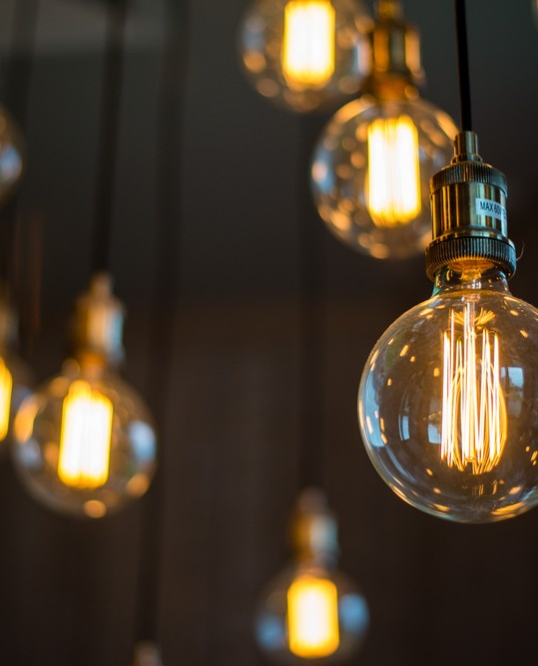
SMART ROOM
for a smart household

Slide 2
This project aims to provide the user with smart room facilities with a smart light and fan system along with control options and analytics via an app interface.
This project has been created under the
guidance of Dr. Badarinath KB by :
MYTHRI NAIK 1RV19CS094
NAVNITH BHARADWAJ 1RV19CS098
NIDHI GK 1RV19CS100
NIKHIL VISHWANATH HEGDE 1RV19CS101
PURNODEEP RAJANKAR 1RV19CS122

Slide 3
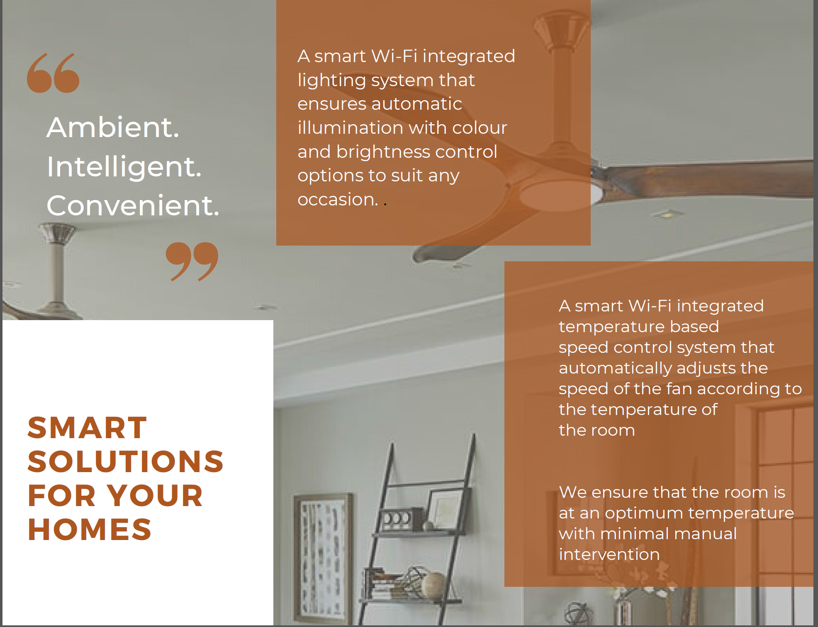
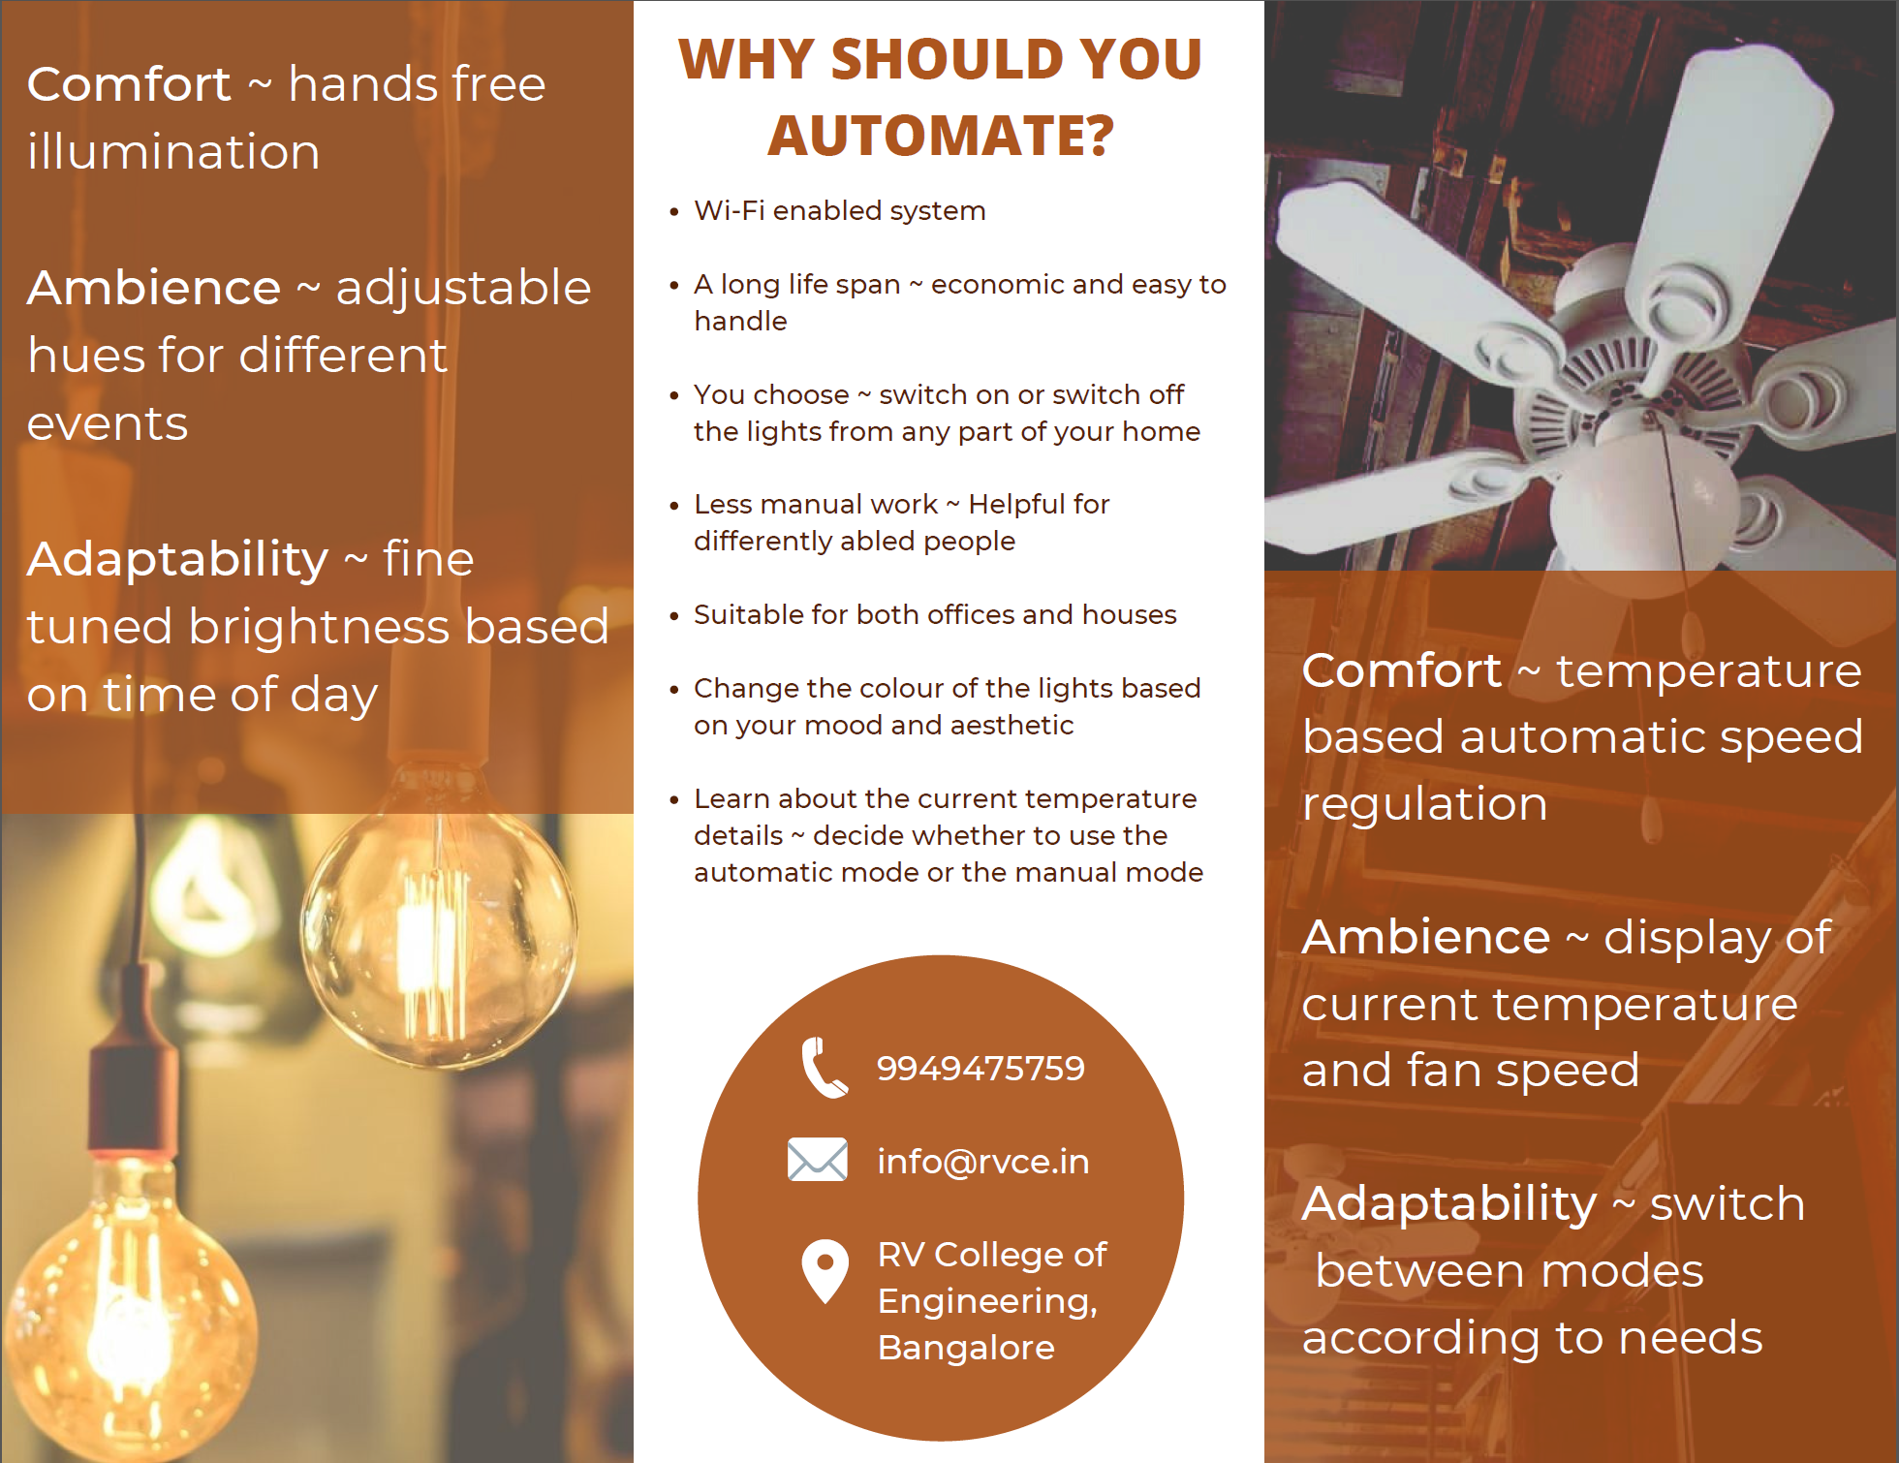
BROCHURE

Slide 4



INTRODUCTION
In the present era of globalization, automation has been making major strides towards making lives more comfortable all around the globe.
We aim to provide the facility of-
A smart lighting system that ensures automatic illumination with color and brightness control options to suit any occasion.
A smart temperature based speed control system that automatically adjusts the speed of the fan according to the temperature of the room.

Slide 5
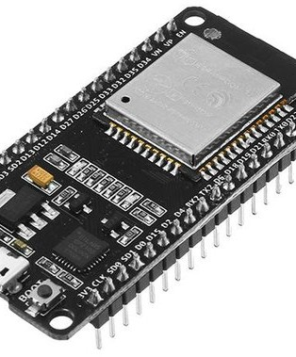
Why ESP32
The ESP32 is a very feature centric development board
The microprocessor used is Tensilica Xtensa 32-bit LX6 with clock frequency up to 240MHz and performs up to 600 DMIPS
Both single and dual core variants are available
The microprocessor of ESP-32 has got a 32 bit dual core CPU
ESP-32 is cost-effective
ESP-32 has got 38 programmable pins
The clock speed being 240kHz, making it faster than the alternatives

Slide 6

WHY AUTOMATE
A long life span - economic and easy to handle
You choose - switch on or switch off the lights from any part of your home
Safe and secure homes
Less manual work - Helpful for differently abled people
Suitable for both offices and houses
Change the color of the lights based on your mood and aesthetic preferences.
Learn about the current temperature details - decide whether to use the automatic mode or the manual mode.

Slide 7
01
Microcontroller-(ESP32)
COMPONENTS REQUIRED
02
Connecting Wires
03
Relays
04
Digital temperature and Humidity sensor (DHT11)

Slide 8
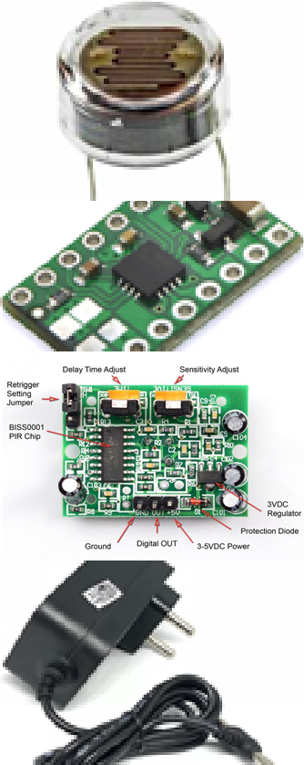
05
Light Dependant Resistors
COMPONENTS REQUIRED
06
DRV10293
Motor Driver
07
Passive Infrared Sensor
08
12V Adapter

Slide 9
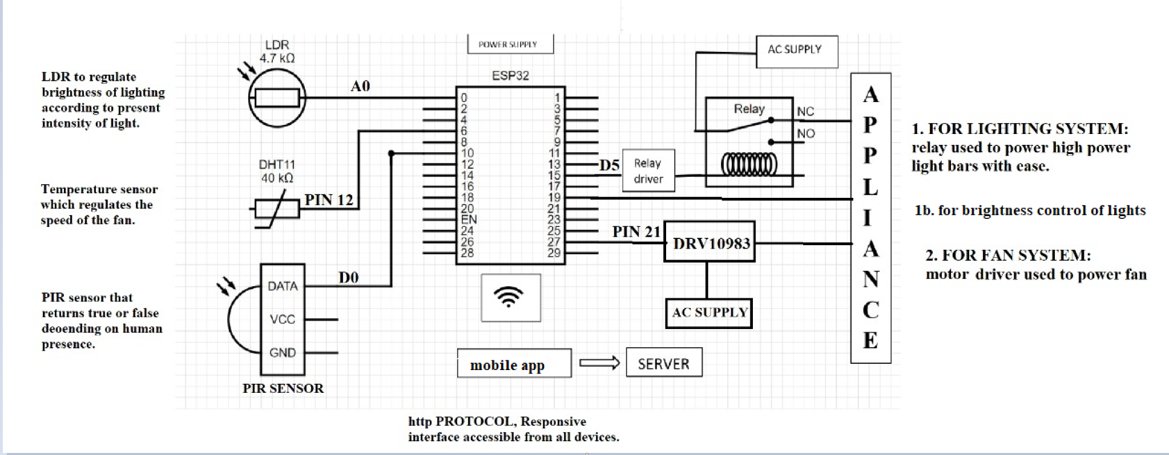
BLOCK DIAGRAM

Slide 10
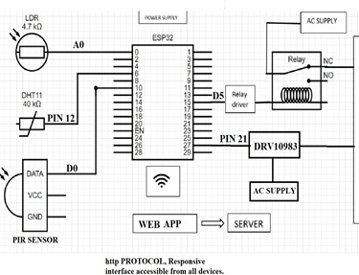
DESCRIPTION OF WORKING
The Microcontroller along with the PIR sensor facilitates the lights and fans in a room turning on automatically on recognizing human presence in the room. Further, the temperature sensor takes into account the present temperature and humidity in the room via which the speed of the fan is regulated to maintain optimum temperature at all times. Through the readings of the LDRs in place, the brightness of the lights are adjusted according to the time of day and present intensity of light in the room.

Slide 11
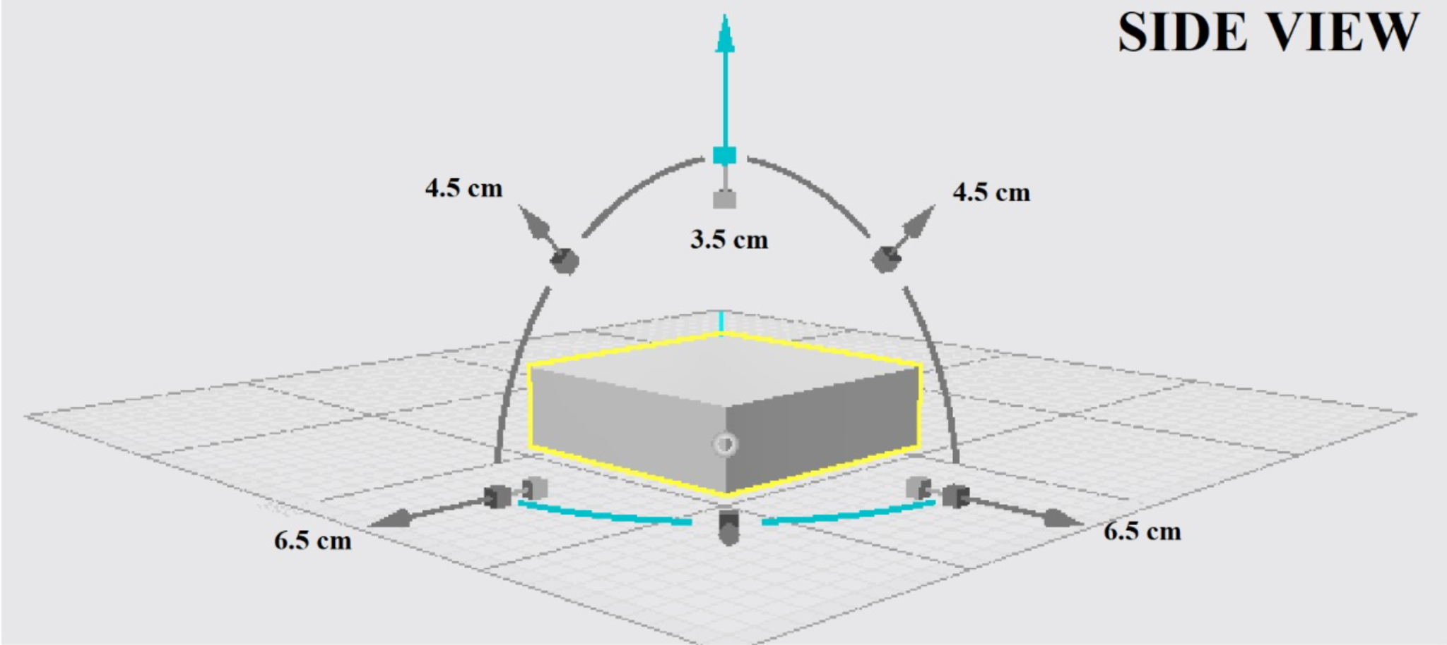
3-D PRODUCT VIEW

Slide 12
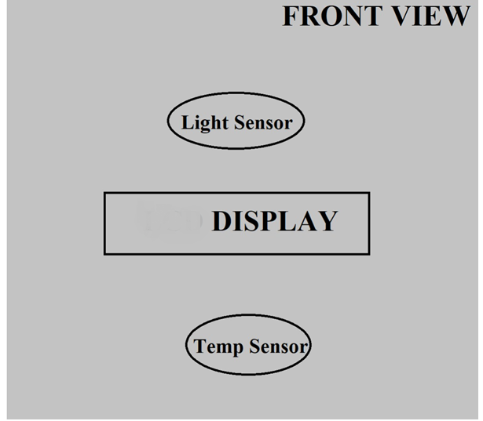
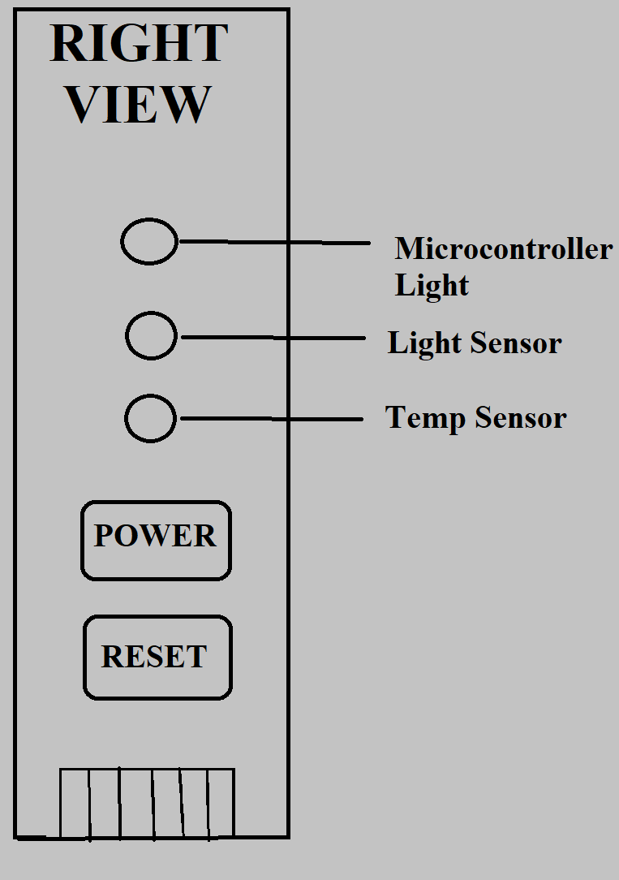

Slide 13
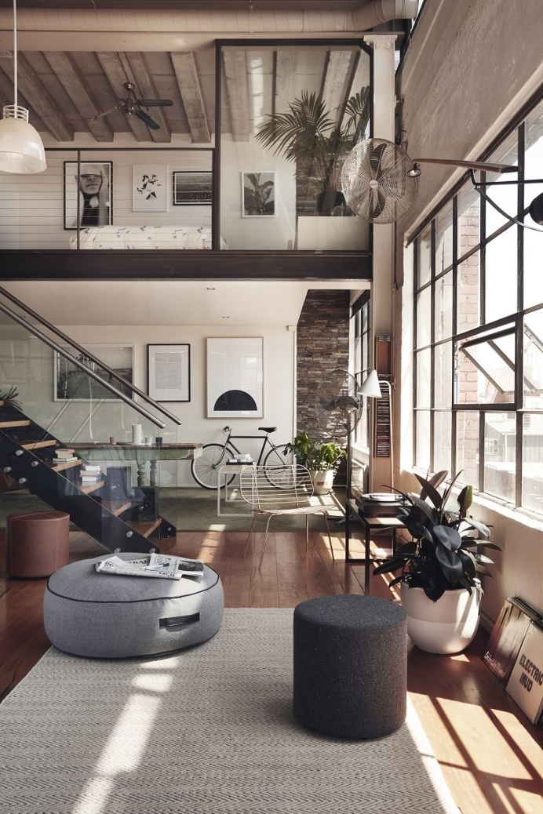
FEATURES PROVIDED
Smart Lights that greet you as you enter the room.
Automatic Temperature Controlled Fan system that ensure optimum temperature at all times with minimum user intervention.
Provision to switch between user and manual modes.
Vary light intensities based on your needs. Inform the system your requirements and the system takes care of the lighting system.
An app interface that is wifi enabled for you to handle controls through your mobile device.
How long have you been using lights? Get analytics via lucid visualisations that help you handle your usage.

Slide 14
THE APP INTERFACE
with ThingSpeak Analytics

Slide 15
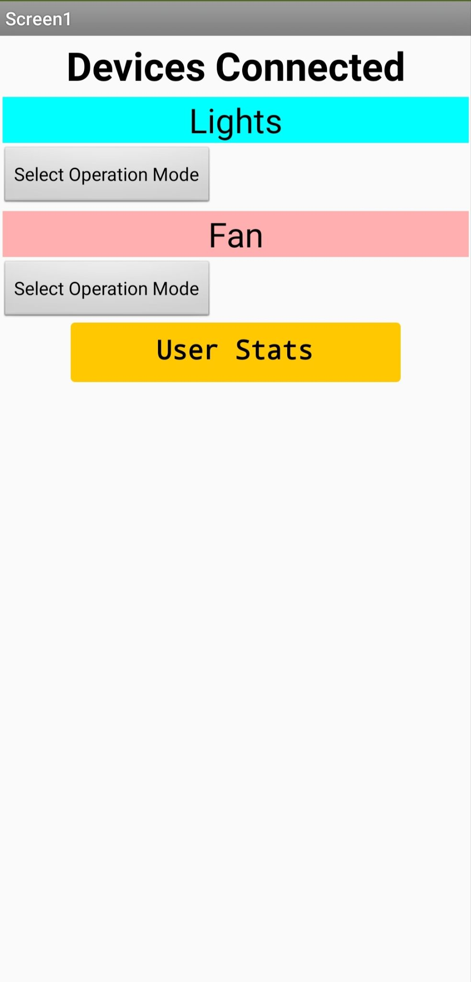
This is the Home Page of the app.
Shows the devices connected and navigation to their operating modes can be done through buttons “Select Operation Mode”
“User Stats” is a button to navigate to usage graph window

Slide 16
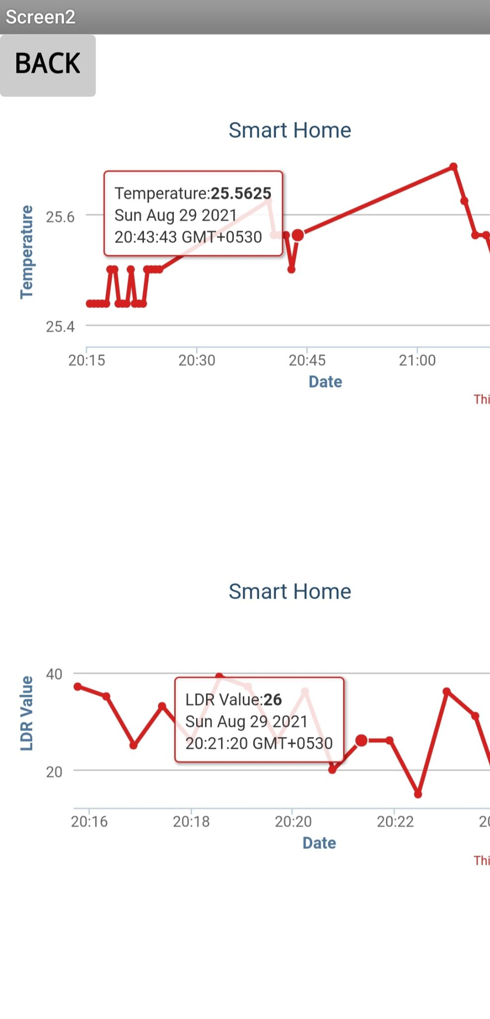
This is the User Statistics page.
First graph shows the temperature recorded and different intervals of time.
Second graph shows the ldr values and different time-stamps

Slide 17
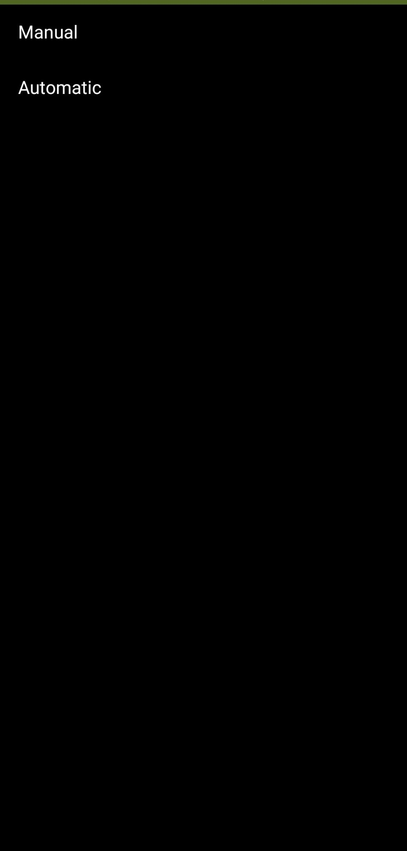
This is the window that enables the user to select the operation mode for the devices.
This control is provided separately for both fans and lights
Based on the user selection the device operates in corresponding mode.

Slide 18
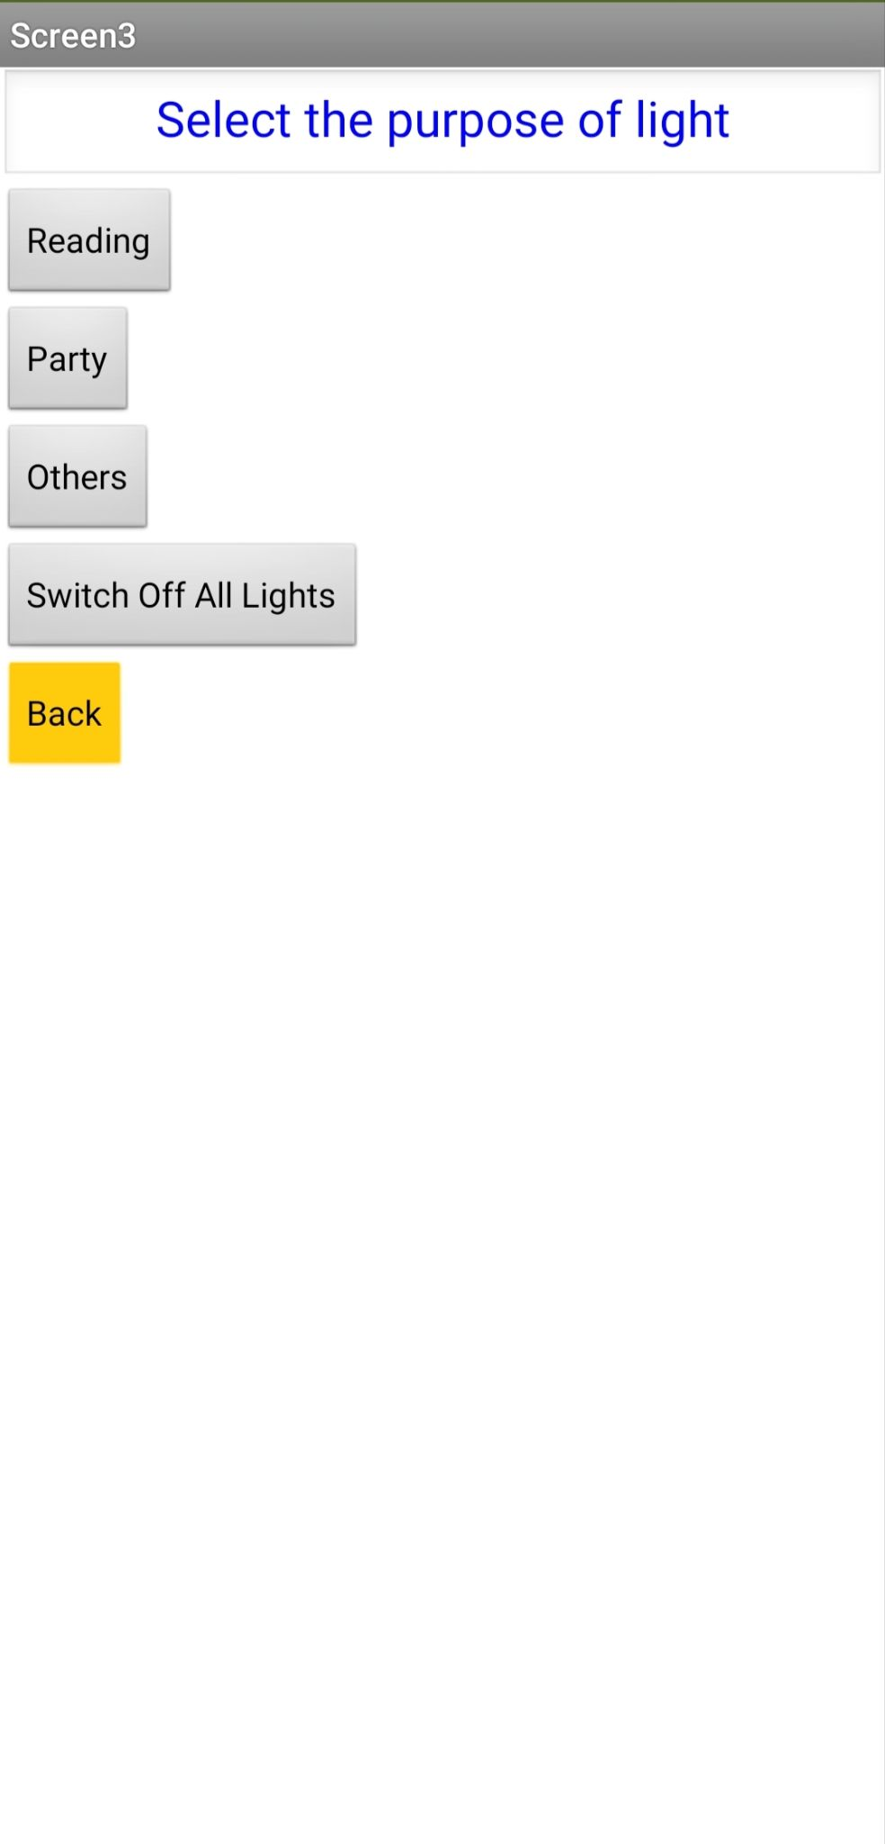
When the user selects manual as the operation mode, control is navigated to this window.
Here the user can select which light the user wants to use.
This provides more flexibility along with the fully automatic mode.

Slide 19
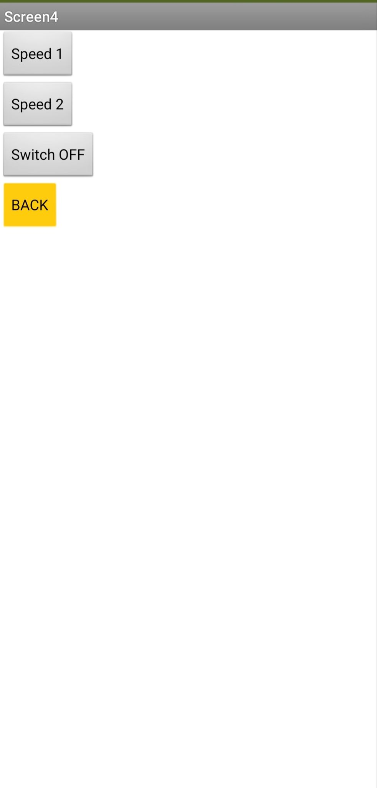
This page gives user to control the fan speeds when manual mode is selected.
Two speeds are provided.
In automatic mode the speeds are automatically decided based on temperature.

Slide 20
DEMONSTRATION VIDEO

Slide 21


Slide 22
REFERENCES
Speed-Control Techniques in AC-DC Operated BLDC Applications, Texas Instruments.
https://www.espressif.com/sites/default/files/documentation/esp32_datasheet_en.pdf
https://components101.com/sites/default/files/component_datasheet/DHT11-Temperature-Sensor.pdf
https://arduino-esp8266.readthedocs.io/en/latest/filesystem.html
https://docs.espressif.com/projects/esp-idf/en/latest/esp32/api-reference/protocols/esp_http_client.html

